Slide 1
Boneman Compression System
A text file compression system implemented with Huffman coding

Slide 2

Title and Content Layout with List
Add your first bullet point here
Add your second bullet point here
Add your third bullet point here

Slide 3
Boneman Compression System
Approach and findings

Slide 4
Objectives
Data Compression: The primary objective is to implement Huffman encoding to compress text files efficiently by encoding the data into a smaller size.
Decompression: Implement the corresponding decompression functionality to recover the original data from the compressed format. Ensure that the decompression process is lossless, meaning that the original data can be fully recovered from the compressed version.

Slide 5
What is Huffman Coding
Huffman coding is a lossless data compression algorithm. The idea is to assign variable-length codes to input characters, lengths of the assigned codes are based on the frequencies of corresponding characters.

Slide 6
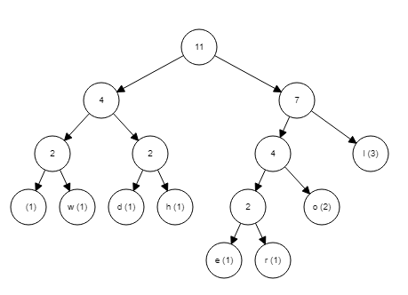
How Huffman Coding works
Huffman code is a way to encode information using variable-length strings to represent symbols depending on how frequently they appear. The idea is that symbols that are used more frequently should be shorter, while symbols that appear more rarely can be more extended. This way, the number of bits it takes to encode a given message will be shorter, on average, than if a fixed-length code was used. In messages that include many rare symbols, the string produced by variable-length encoding may be longer than one produced by a fixed-length encoding.

Slide 7
What is Huffman Coding
The time complexity for encoding each unique character based on its frequency is O(nlog n). N is the number of symbols being coded.

Slide 8
Boneman Compression System
Results

Slide 9
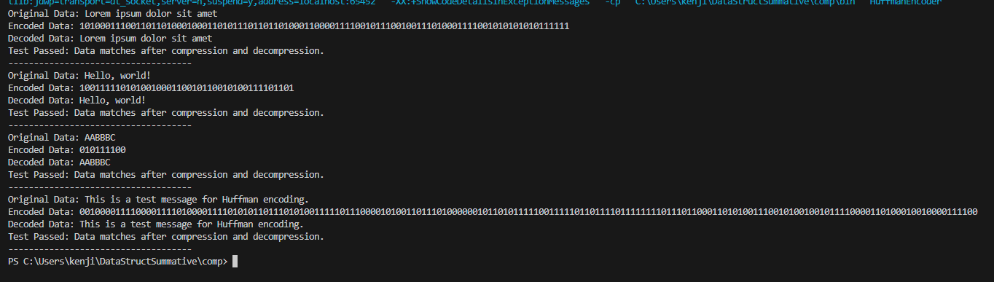
Test Case Results in console
In the output of the test cases in the console, it is shown that the string is encoded correctly and compressed. The encoded data is generated based on the Huffman tree structure, ensuring that the Huffman code for each character is unique and can be easily decoded.

Slide 10

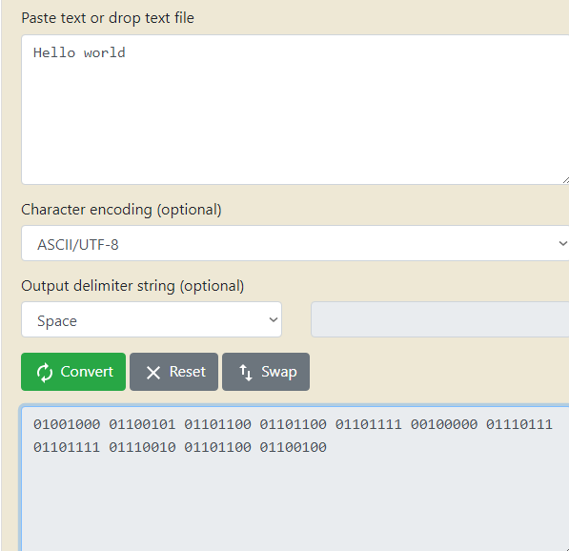
Test Case Results in console
Original Data: "Hello, world!" Huffman Codes:
Encoded Data: "100111110101001000110010110010100111101101"
The algorithm uses the provided Huffman tree and replaces each character with its corresponding code, resulting in the encoded data.
For comparison, “Hello world” has a binary string length of 89 characters. But when “Hello world” is encoded through Huffman coding, it now has a binary string length of 42.

Slide 11
Test Case Results in Text file compression
When the "Compress File" button is clicked, the program allows the user to select an input file. It then reads the content of the file, compresses it using the HuffmanEncoder.
When the "Decompress File" button is clicked, the program allows the user to select a compressed file. It reads the compressed data, uses the HuffmanEncoder to decompress it.
As it is a lossless compression system, all the data that was compressed was not lost and still retains the original data.

Slide 12
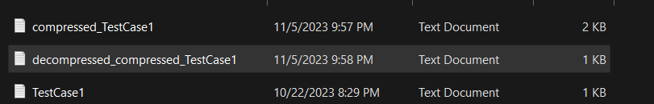
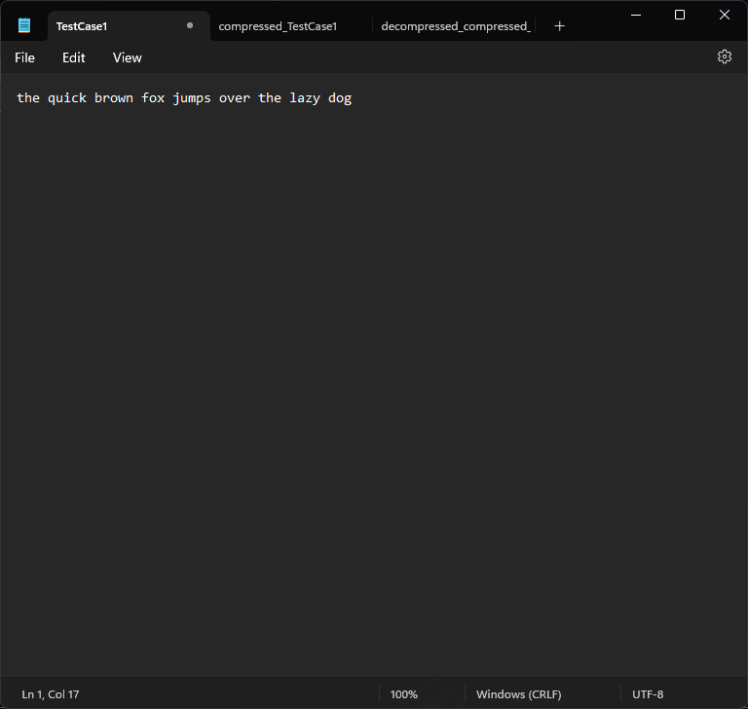
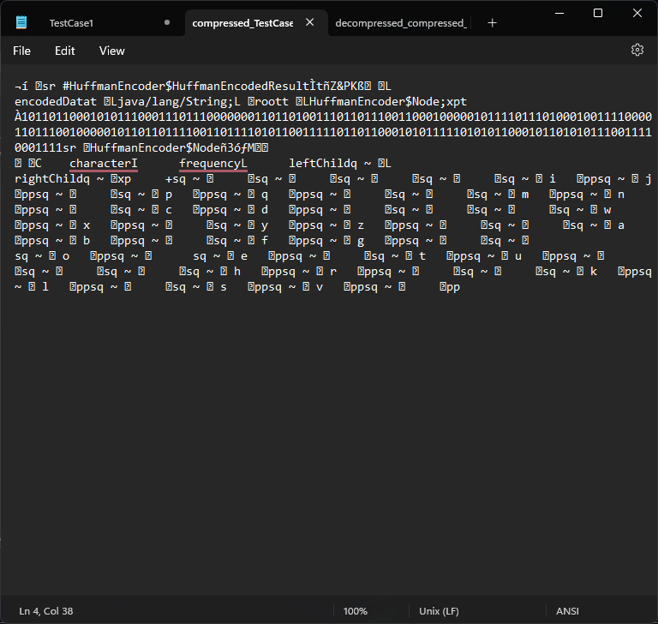
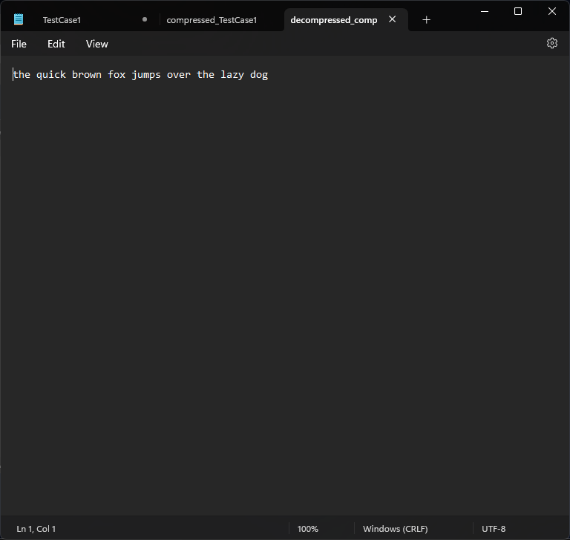

Slide 13
Limitations
Lossless Compression: Huffman coding is a lossless compression technique, which means it can only be used for compressing data where loss of information is not acceptable.
Inefficiency for Small Data: Huffman coding may be inefficient for very small datasets. The overhead of storing the Huffman tree and codes can outweigh the compression benefits for short input strings. Therefore, making the compressed files bigger than the original.

Slide 14
Further improvements
Implement support for other file types like image files.
Utilize other compression algorithms with Huffman coding to further improve compression like DEFLATE which is a combination of LZ77 and Huffman Coding.

Slide 15
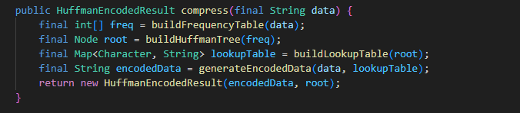
Code Explaination
The core class in the code is HuffmanEncoder, which offers methods for both compression and decompression. In the compression process, the compress method takes a string as input and performs the following steps: it builds a frequency table for each character in the input string, constructs a Huffman tree based on these frequencies, generates a lookup table mapping characters to their Huffman codes, and then uses this table to encode the input data. The result is a HuffmanEncodedResult object containing the encoded data and the root of the Huffman tree.

Slide 16
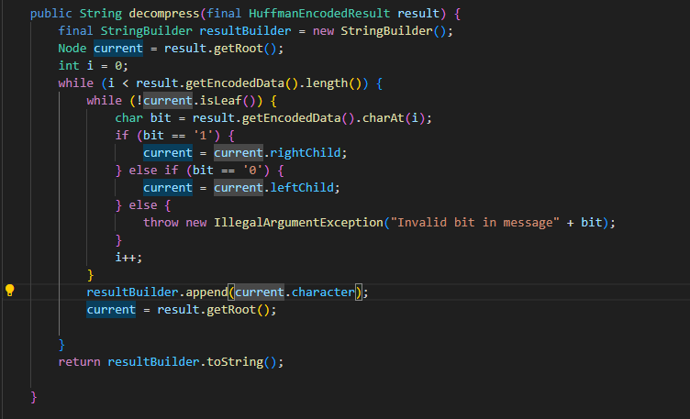
Code Explaination
Conversely, the decompress method takes a HuffmanEncodedResult as input and reverses the encoding process. It iterates through the encoded data bit by bit, following the Huffman tree's path to decode characters, and eventually reconstructs the original string.

Slide 17
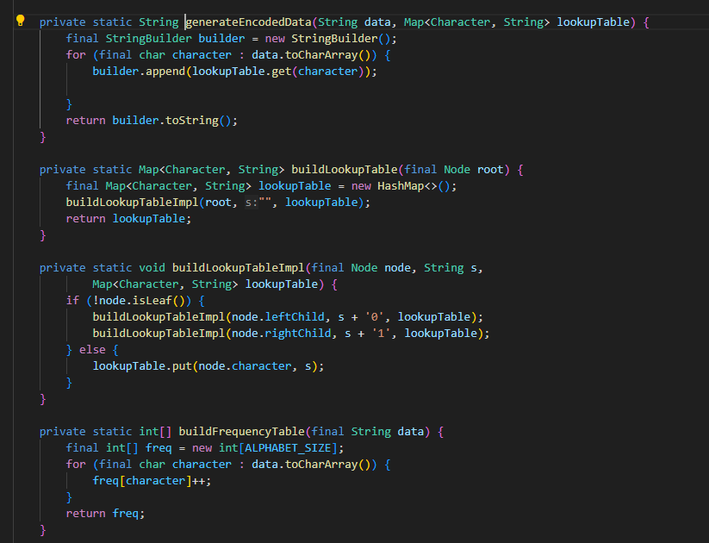
Code Explaination
Supporting these main methods are utility functions such as generateEncodedData, buildLookupTable, and buildFrequencyTable. The Node class represents nodes of the Huffman tree, holding character information and frequency counts. There's also a testEncodingAndDecoding method inside the Node class, which is used for testing the encoding and decoding process on different input strings to ensure data integrity.

Slide 18
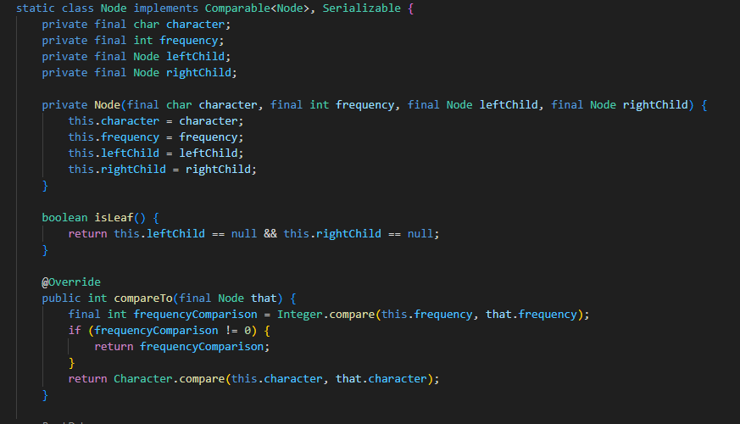
Code Explaination
Supporting these main methods are utility functions such as generateEncodedData, buildLookupTable, and buildFrequencyTable. The Node class represents nodes of the Huffman tree, holding character information and frequency counts. There's also a testEncodingAndDecoding method inside the Node class, which is used for testing the encoding and decoding process on different input strings to ensure data integrity.

